Slide 1
Module 7.3 RSA Public Key Crypto

Slide 2
RSA Public Keys
Named for Ron Rivest, Adi Shamir, and Len Adleman, published in 1978.
Most widely known and used public key system.
No shared secret is required.
Based on some number-theoretic facts/results.
Strength lies in the difficulty of determining the prime factors of a (large) number.
Hardware improvements will not weaken RSA as long as appropriate key lengths are used.

Slide 3
RSA Key Generation
Pick large random primes p,q.
Let p*q = n and φ=(p-1)(q-1).
Choose a random number e such that: 1<e<φ and gcd(e, φ)=1. (relative primes)
Calculate the unique number d such that 1<d<φ and d*e ≡ 1 (mod φ). (d is inverse of e)
The public key is {e,n} and the private key is {d,n}.
The factors p and q may be kept private or destroyed.

Slide 4
Encryption and Decryption
Suppose Alice wants to send a message m to Bob.
Alice computes c = m^{e} mod n, where {e,n} is Bob’s public key.
She sends c to Bob.
To decrypt, Bob computes m = c^{d} mod n, where {d,n} is Bob’s private key.
The mathematical relationship between e and d ensures that Bob correctly recovers m.
Since only Bob knows d, only he can decrypt.

Slide 5
RSA - Authentication
Suppose Alice wants to send a message m to Bob and assure him that the message is indeed from her.
Alice computes signature s = m^{d} mod n, where {d,n} is Alice’s private key.
She sends m and s to Bob.
To verify the signature, Bob computes using {e,n} m = s^{e} mod n and checks that it is recovered.
In practice, RSA is combined with a symmetric key cryptosystem (e.g., DES) to encrypt.
RSA is usually combined with a hash function to sign a message.

Slide 6
Why Does it Work?
It is secure because it is difficult to find φ or d using only e and n. Finding d is equivalent in difficulty to factoring n as p*q.
It is feasible to encrypt and decrypt because:
It is possible to find large primes.
It is possible to find relative primes and their inverses.
Modular exponentiation is feasible.

Slide 7
RSA - Example
Let p = 47 and q = 71
then n = p*q = 3337
(p-1)*(q-1) = 3220 = Φ_{n}
Choose (at random) e = 79 [check using GCD (Greatest Common Divisor) that Φ_{n} and e are relatively prime.]
Compute d = 79⁻¹ mod 3220 = 1019
Private key: {79, 3337}
Public key: {1019, 3337}
Let message m be 6882326879666683.
To encrypt, first break it into blocks < n. [required condition]

Slide 8
RSA - Example (continued)
Let message consists of the following blocks:
688, 232, 687, 966, 668, 003
For the first block
688⁷⁹ mod 3337 = 1570 = c₁
For the entire message we have
1570, 2756, 2091, 2276, 2423, 158
To decrypt first block
1570¹⁰¹⁹ mod 3337 = 688
The rest of the message can be recovered in the same manner.

Slide 9
More on RSA
RSA has been implemented in hardware.
In hardware, RSA is about 1000 times slower than DES.
In software, it is about 100 times slower.
These numbers may change, but RSA can never approach the speed of symmetric algorithms.
RSA encryption goes faster if e is chosen appropriately.
Security of RSA depends on the problem of factoring large numbers. Though it has never been proven that one needs to factor n to calculate m from c and e.
Most public key systems use at least 2048-bit key.

Slide 10
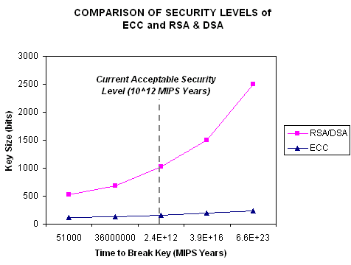
Key Lengths
The longer the key, the longer it takes to do an exhaustive key search. The problem space is to find the private key.
The longer the key, the greater the computational power required to perform cryptographic operations.
This means a tradeoff between security and time/power.
Time and power become important for portable devices (cell phones, smart cards, …).
Popular key lengths:
DES = 56 bits
3-DES = 168 bits
RSA = 2048 bits
ECC < RSA for comparable cryptographic security.

Slide 11
Hybrid Cryptosystems
In practice, public-key cryptography is used to secure and distribute session keys.
These keys are used with symmetric algorithms for communication.
Sender generates a random session key, encrypts it using receiver’s public key and sends it.
Receiver decrypts the message to recover the session key.
Both encrypt/decrypt their communications using the same key.
Key is destroyed in the end.

Slide 12
Digital Envelope
K
M
E_{S}
K_{R(pub)}
K
E_{A}
K is a random session key and E_{s} is a symmetric encryption algorithm and E_{A} is an asymmetric encryption algorithm. The receiver recovers the secret key from the digital envelope using his/her private key. He/she then uses the secret key to decrypt the message.

Slide 13
Module 7.4 Digital Signature, Hash Functions

Slide 14
Digital Signatures
A digital signature is a protocol the produces the same effect as a real signature.
It is a mark that only sender can make
Other people can easily recognize it as belonging to the sender.
Digital signatures must be:
Unforgeable: If P signs message M with signature S(P,M), it is impossible for someone else to produce the pair [M, S(P,M)].
Authentic: R receiving the pair [M, S(P,M)] can check that the signature is really from P.

Slide 15
Digital Signatures: Symmetric Key
Under private key encryption system, the secrecy of the key guarantees the authenticity of the message as well as its secrecy.
It does not prevent forgery, however.
There is no protection against repudiation (denial of sending a message).
An arbitrator (a trusted third party) is needed to prevent forgery.

Slide 16
Digital Signatures - Public Key
Public key encryption systems are ideally suited to digital signatures.
Reverse of public key encryption/decryption.
To sign a message, use your private key to encrypt the message.
Send this signature together with the message.
The receiver can verify the signature using your public key.
Only you could have signed the message since your private key belongs to you and only you.
The receiver saves the message and signature and anyone else can verify should you claim forgery.

Slide 17
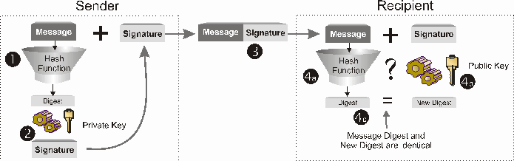
Digital Signature Process

Slide 18
Message Digest
How to assure integrity
Alice makes a message digest from a plaintext message.
Alice signs the message digest and sends the signed digest and plaintext to Bob
Bob re-computes the message digest from the plaintext.
Bob decrypts the signed digest with Alice’s public key.
Bob verifies that message is authentic if the message digest he computed is identical to the decrypted digest signed by Alice.

Slide 19
Possible Scenarios
Message
Plaintext, can be altered
Message, E(Message-digest, pub-key)
Plaintext, encrypted msg digest
E(message,sym-key), E(message-digest,pub-key)
Cipher-text, encrypted msg digest

Slide 20
Cryptographic Hash Functions
Hash functions are used in creating “digital fingerprint” of a large message.
Requirements of such hash functions are:
easy to compute (i.e., reduce a message of variable size to a small digest of fixed size)
one-way, that is, hard to invert
collision-free (the probability that a randomly chosen message maps to an n-bit hash should ideally be ½ **n)
To sign a message, first apply a hash function to create a message digest, encrypt the digest using private key and send it along with the message.

Slide 21
Uses for Hashing Algorithms
Hash functions without secret keys are used:
To condense a message for digital signature.
To check the integrity of an input if the hash has been previously recorded.
Such functions are called Modification Detection Codes (MDC’s).
Hash functions that use secret keys are called Message Authentication Codes (MAC’s).
They are used for data origin authentication.
MD5, SHA, SHA-2, SHA-3, SHA-256 etc.

Slide 22
Module 7.5 Public Key Distribution

Slide 23
Public Key Distribution
Every user has his/her own public key and private key.
Public keys are all published in a database.
Sender and receiver agree on a cryptosystem.
Sender gets receiver’s public key from the db.
Sender encrypts the message and sends it.
Receiver decrypts it using his/her private key.
What can be a problem?

Slide 24
Matching keys to owners
Insecurity of TCP/IP
No authentication
No privacy/confidentiality
Repudiation possible
Public key cryptography not enough
Need to match keys to owners
Need infrastructure and certificate authorities

Slide 25
Public Key Infrastructure (PKI)
As defined by Netscape:
“Public-key infrastructure (PKI) is the combination of software, encryption technologies, and services that enables enterprises to protect the security of their communications and business transactions on the Internet.”
Integrates digital certificates, public key cryptography, and certification authorities
Two major frameworks
X.509
PGP (Pretty Good Privacy)

Slide 26
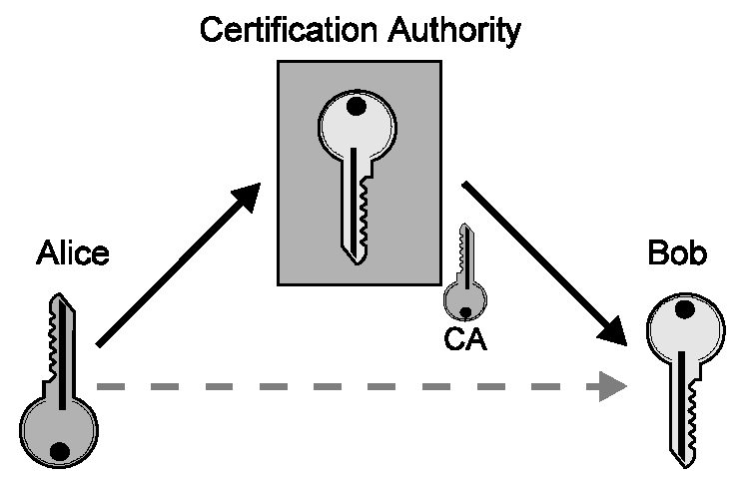
Certification Authorities (CAs)

Slide 27
Certification Authorities (cont.)
Guarantee connection between public key and end entity
Man-In-Middle no longer works undetected
Guarantee authentication and non-repudiation
Privacy/confidentiality not an issue here
Only concerned with linking key to owner
Distribute responsibility
Hierarchical structure

Slide 28
Digital Certificates
Introduced by IEEE-X.509 standard (1988)
Originally intended for accessing IEEE-X.500 directories
Concerns over misuse and privacy violation gave rise to need for access control mechanisms
X.509 certificates addressed this need
From X.500 comes the Distinguished Name (DN) standard
Common Name (CN)
Organizational Unit (OU)
Organization (O)
Country (C)
Supposedly enough to give every entity on Earth a unique name

Slide 29
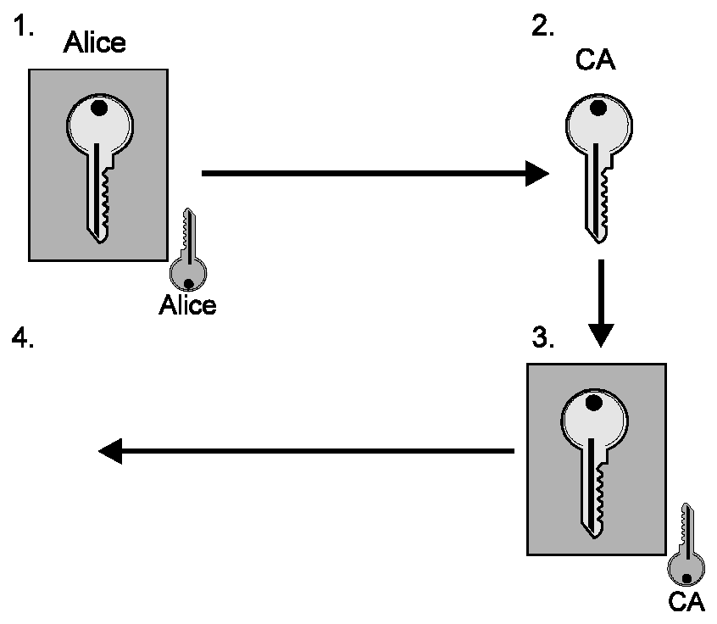
Obtaining Certificates

Slide 30
Obtaining Certificates
1. Alice generates A_{priv}, A_{pub} and A_{ID}; Signs {A_{pub}, A_{ID}} with A_{priv}
Proves Alice holds corresponding A_{priv}
Protects {A_{pub}, A_{ID}} en route to CA
2. CA verifies signature on {A_{pub}, A_{ID}}
Verifies A_{ID} offline (optional)
3. CA signs {A_{pub}, A_{ID}} with CA_{priv}
Creates certificate
Certifies binding between A_{pub} and A_{ID}
Protects {A_{pub}, A_{ID}} en route to Alice
4. Alice verifies {A_{pub}, A_{ID}} and CA signature
Ensures CA didn’t alter {A_{pub}, A_{ID}}
5. Alice and/or CA publishes certificate

Slide 31
PKI: Benefits
Provides authentication
Verifies integrity
Ensures privacy
Authorizes access
Authorizes transactions
Supports non-repudiation

Slide 32
PKI: Risks
Certificates only as trustworthy as their CAs
Root CA is a single point of failure
PKI only as secure as private signing keys
DNS not necessarily unique
Server certificates authenticate DNS addresses, not site contents
CA may not be authority on certificate contents
i.e., DNS name in server certificates
...

Slide 33
Module 7.6 Real World Protocols

Slide 34
Real-World Protocols
Secure Sockets Layer (SSL)
Client/server authentication, secure data exchange
Secure Multipurpose Internet Mail Extensions Protocol (S/MIME), PGP
Secure Electronic Transactions (SET)
Internet Protocol Secure Standard (IPSec)
Authentication for networked devices

Slide 35
Basics Steps
Authenticate (validate the other side)
Key agreement/exchange (agree on or exchange a secret key)
Confidentiality (exchange encrypted messages)
Integrity (proof message not modified)
Nonrepudiation (proof you got exactly what you want)

Slide 36
Secure Sockets Layer (SSL)
Developed by Netscape
Provides privacy
Encrypted connection
Confidentiality and tamper-detection
Provides authentication
Authenticate server
Authenticate client optionally

Slide 37
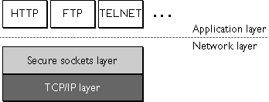
Secure Sockets Layer (cont.)
Lies above transport layer, below application layer
Can lie atop any transport protocol, not just TCP/IP
Runs under application protocols like HTTP, FTP, and TELNET

Slide 38
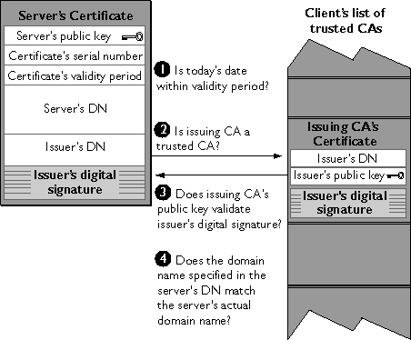
SSL: Server Authentication

Slide 39
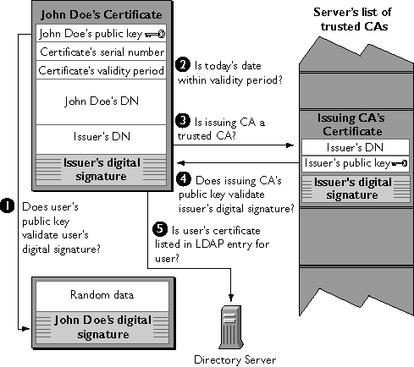
SSL: Client Authentication

Slide 40
References
J. Bradley. The SSLP Reference Implementation Project. Department of Computer Science, University of Bristol, UK.
C. Ellison and B. Schneier. “Ten Risks of PKI: What You’re not Being Told about Public Key Infrastructure,” Computer Security Journal, Vol. XVI, No. 1, 2000.
P. Gutmann. Encryption and Security Tutorial. Department of Computer Science, University of Auckland, NZ.
Netscape Communications Corporation website.
B. Schneier. “Chapter 1: Foundations,” Applied Cryptography, Second Edition.

Slide 41
Module 7.7 Network Security

Slide 42

Network Security Protocols

Slide 43
Network Security
Application layer
E-mail: PGP, using a web-of-trust
Web: HTTP-S, using a certificate hierarchy
Transport layer
Transport Layer Security/ Secure Socket Layer
Network layer
IP Sec
Network infrastructure
DNS-Sec and BGP-Sec

Slide 44
Basic Security Properties
Confidentiality:
Authenticity:
Integrity:
Availability:
Non-repudiation:
Access control:

Slide 45
Basic Security Properties
Confidentiality: Concealment of information or resources
Authenticity: Identification and assurance of origin of info
Integrity: Trustworthiness of data or resources in terms of preventing improper and unauthorized changes
Availability: Ability to use desired information or resource
Non-repudiation: Offer of evidence that a party indeed is sender or a receiver of certain information
Access control: Facilities to determine and enforce who is allowed access to what resources (host, software, network, …)

Slide 46
Encryption and MAC/Signatures
Confidentiality (Encryption)
Sender:
Compute C = Enc_{K}(M)
Send C
Receiver:
Recover M = Dec_{K}(C)
Auth/Integrity (MAC / Signature)
Sender:
Compute s = Sig_{K}(Hash (M))
Send <M, s>
Receiver:
Compute s’ = Ver_{K}(Hash (M))
Check s’ == s
These are simplified forms of the actual algorithms

Slide 47
Email Security: Pretty Good Privacy (PGP)

Slide 48
E-Mail Security
Security goals
Confidentiality: only intended recipient sees data
Integrity: data cannot be modified en route
Authenticity: sender and recipient are who they say
Security non-goals
Timely or successful message delivery
Avoiding duplicate (replayed) message
(Since e-mail doesn’t provide this anyway!)

Slide 49

Sender and Receiver Keys
If the sender knows the receiver’s public key
Confidentiality
Receiver authentication
If the receiver knows the sender’s public key
Sender authentication
Sender non-repudiation

Slide 50
Sending an E-Mail Securely
Sender digitally signs the message
Using the sender’s private key
Sender encrypts the data
Using a one-time session key
Sending the session key, encrypted with the receiver’s public key
Sender converts to an ASCII format
Converting the message to base64 encoding
(Email messages must be sent in ASCII)

Slide 51

Public Key Certificate
Binding between identity and a public key
“Identity” is, for example, an e-mail address
“Binding” ensured using a digital signature
Contents of a certificate
Identity of the entity being certified
Public key of the entity being certified
Identity of the signer
Digital signature
Digital signature algorithm id

Slide 52
Web of Trust for PGP
Decentralized solution
Protection against government intrusion
No central certificate authorities
Customized solution
Individual decides whom to trust, and how much
Multiple certificates with different confidence levels
Key-signing parties!
Collect and provide public keys in person
Sign other’s keys, and get your key signed by others

Slide 53
HTTP Security

Slide 54


HTTP Threat Model
Eavesdropper
Listening on conversation (confidentiality)
Man-in-the-middle
Modifying content (integrity)
Impersonation
Bogus website (authentication, confidentiality)

Slide 55
HTTP-S: Securing HTTP
HTTP sits on top of secure channel (SSL/TLS)
https:// vs. http://
TCP port 443 vs. 80
All (HTTP) bytes encrypted and authenticated
No change to HTTP itself!
Where to get the key???
HTTP
Secure Transport Layer
TCP
IP
Link layer

Slide 56
Learning a Valid Public Key
What is that lock?
Securely binds domain name to public key (PK)
If PK is authenticated, then any message signed by that PK cannot be forged by non-authorized party
Believable only if you trust the attesting body
Bootstrapping problem: Who to trust, and how to tell if this message is actually from them?

Slide 57
Hierarchical Public Key Infrastructure
Public key certificate
Binding between identity and a public key
“Identity” is, for example, a domain name
Digital signature to ensure integrity
Certificate authority
Issues public key certificates and verifies identities
Trusted parties (e.g., VeriSign, GoDaddy, Comodo)
Preconfigured certificates in Web browsers

Slide 58
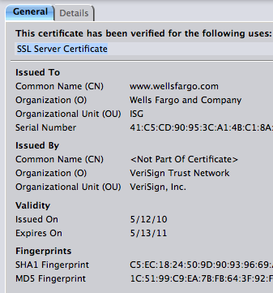
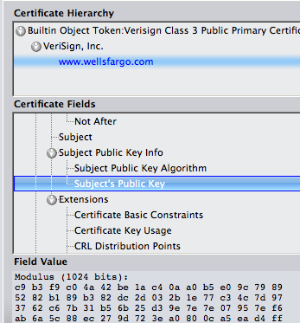
Public Key Certificate

Slide 59
Transport Layer Security (TLS)
Based on the earlier Secure Socket Layer (SSL) originally developed by Netscape

Slide 60
TLS Handshake Protocol
Send new random value, list of supported ciphers
Send pre-secret, encrypted under PK
Create shared secret key from pre-secret and random
Switch to new symmetric-key cipher using shared key
Send new random value, digital certificate with PK
Create shared secret key from pre-secret and random
Switch to new symmetric-key cipher using shared key

Slide 61
TLS Record Protocol
Messages from application layer are:
Fragmented or coalesced into blocks
Optionally compressed
Integrity-protected using an HMAC
Encrypted using symmetric-key cipher
Passed to the transport layer (usually TCP)
Sequence #s on record-protocol messages
Prevents replays and reorderings of messages

Slide 62
Comments on HTTPS
HTTPS authenticates server, not content
If CDN (Akamai) serves content over HTTPS, customer must trust Akamai not to change content
Symmetric-key crypto after public-key ops
Handshake protocol using public key crypto
Symmetric-key crypto much faster (100-1000x)
HTTPS on top of TCP, so reliable byte stream
Can leverage fact that transmission is reliable to ensure: each data segment received exactly once
Adversary can’t successfully drop or replay packets

Slide 63
IP Security

Slide 64
IP Security
There are range of app-specific security mechanisms
eg. TLS/HTTPS, S/MIME, PGP, Kerberos, …
But security concerns that cut across protocol layers
Implement by the network for all applications?
Enter IPSec!

Slide 65
IPSec
General IP Security framework
Allows one to provide
Access control, integrity, authentication, originality, and confidentiality
Applicable to different settings
Narrow streams: Specific TCP connections
Wide streams: All packets between two gateways

Slide 66
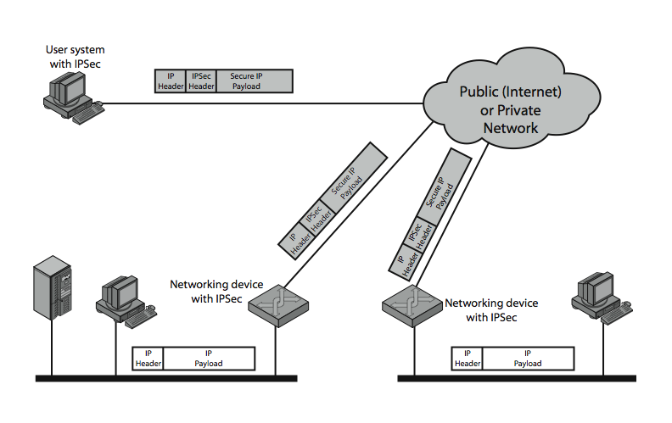
IPSec Uses

Slide 67
Benefits of IPSec
If in a firewall/router:
Strong security to all traffic crossing perimeter
Resistant to bypass
Below transport layer
Transparent to applications
Can be transparent to end users
Can provide security for individual users

Slide 68
IP Security Architecture
Specification quite complex
Mandatory in IPv6, optional in IPv4
Two security header extensions:
Authentication Header (AH)
Connectionless integrity, origin authentication
MAC over most header fields and packet body
Anti-replay protection
Encapsulating Security Payload (ESP)
These properties, plus confidentiality
Notes:
Not as robust: Can detect duplicates, but not lost or re-ordered…
• RFC 2401: An overview of a security architecture
• RFC 2402: Description of a packet authentication extension to IPv4 and IPv6
• RFC 2406: Description of a packet encryption extension to IPv4 and IPv6
• RFC 2408: Specification of key management capabilities

Slide 69
Encapsulating Security Payload (ESP)
Transport mode: Data encrypted, but not header
After all, network headers needed for routing!
Can still do traffic analysis, but is efficient
Good for host-to-host traffic
Tunnel mode: Encrypts entire IP packet
Add new header for next hop
Good for VPNs, gateway-to-gateway security

Slide 70
Replay Protection is Hard
Goal: Eavesdropper can’t capture encrypted packet and duplicate later
Easy with TLS/HTTP on TCP: Reliable byte stream
But IP Sec at packet layer; transport may not be reliable
IP Sec solution: Sliding window on sequence #’s
All IPSec packets have a 64-bit monotonic sequence number
Receiver keeps track of which seqno’s seen before
[lastest – windowsize + 1 , latest] ; windowsize typically 64 packets
Accept packet if
seqno > latest (and update latest)
Within window but has not been seen before
If reliable, could just remember last, and accept iff last + 1

Slide 71
DNS Security

Slide 72
Hierarchical Naming in DNS
unnamed root
com
edu
org
ac
uk
zw
arpa
generic domains
country domains
bar
ac
in-
addr
west
east
cam
12
foo
my
usr
34
my.east.bar.edu
usr.cam.ac.uk
56
12.34.56.0/24

Slide 73
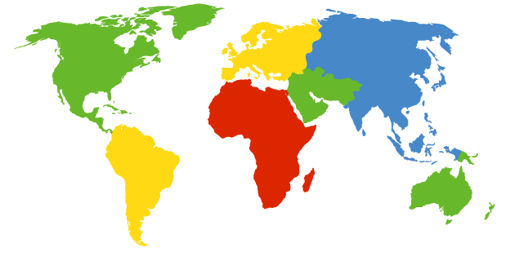
DNS Root Servers
13 root servers (see http://www.root-servers.org/)
Labeled A through M
A Verisign, Dulles, VA
C Cogent, Herndon, VA (also Los Angeles)
D U Maryland College Park, MD
G US DoD Vienna, VA
H ARL Aberdeen, MD
J Verisign, ( 11 locations)
K RIPE London (+ Amsterdam, Frankfurt)
I Autonomica, Stockholm (plus 3 other locations)
E NASA Mt View, CA
F Internet Software C. Palo Alto, CA (and 17 other locations)
m WIDE Tokyo
B USC-ISI Marina del Rey, CA
L ICANN Los Angeles, CA

Slide 74
DoS attacks on DNS Availability
Feb. 6, 2007
Botnet attack on the 13 Internet DNS root servers
Lasted 2.5 hours
None crashed, but two performed badly:
g-root (DoD), l-root (ICANN)
Most other root servers use anycast

Slide 75
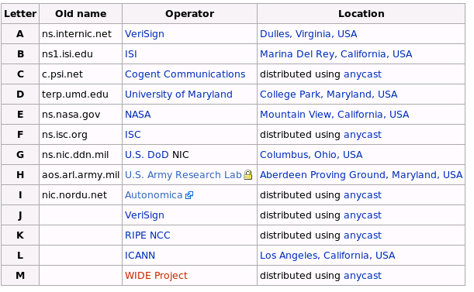
Defense: Replication and Caching
source: wikipedia

Slide 76
Denial-of-Service Attacks on Hosts
×40 amplification
DNS Query SrcIP: DoS Target
(60 bytes)
DNS Response
(3000 bytes)
DNS Server
DoS Source
DoS Target
580,000 open resolvers on Internet (Kaminsky-Shiffman’06)

Slide 77

Preventing Amplification Attacks
attacker
ip spoofed packets
open
amplifier
replies
prevent
ip spoofing
disable
open amplifiers
victim

Slide 78
DNS Integrity and the TLD Operators
If domain name doesn’t exist, DNS should return NXDOMAIN (non-existant domain) msg
Verisign instead creates wildcard records for all .com and .net names not yet registered
September 15 – October 4, 2003
Redirection for these domain names to Verisign web portal: “to help you search”
And serve you ads…and get “sponsored” search
Verisign and online advertising companies make $$

Slide 79
DNS Integrity: Cache Poisoning
Was answer from an authoritative server?
Or from somebody else?
DNS cache poisoning
Client asks for www.evil.com
Nameserver authoritative for www.evil.com returns additional section for (www.cnn.com, 1.2.3.4, A)
Thanks! I won’t bother check what I asked for

Slide 80
DNS Integrity: DNS Hijacking
To prevent cache poisoning, client remembers:
The domain name in the request
A 16-bit request ID (used to demux UDP response)
DNS hijacking
16 bits: 65K possible IDs
What rate to enumerate all in 1 sec? 64B/packet
64*65536*8 / 1024 / 1024 = 32 Mbps
Prevention: also randomize DNS source port
Kaminsky attack: this source port… wasn’t random
http://unixwiz.net/techtips/iguide-kaminsky-dns-vuln.html

Slide 81
Let’s strongly believe the answer! Enter DNSSEC
DNSSEC protects against data spoofing and corruption
DNSSEC also provides mechanisms to authenticate servers and requests
DNSSEC provides mechanisms to establish authenticity and integrity

Slide 82
PK-DNSSEC (Public Key)
The DNS servers sign the hash of resource record set with its private (signature) keys
Public keys can be used to verify the SIGs
Leverages hierarchy:
Authenticity of name server’s public keys is established by a signature over the keys by the parent’s private key
In ideal case, only roots’ public keys need to be distributed out-of-band

Slide 83
Verifying the Tree
Question: www.cnn.com ?
. (root)
dns.cs.princeton.edu
www.cnn.com A ?
src.cs.princeton.edu
ask .com server
SIG (ip addr and PK of .com server)
resolver
stub
resolver
www.cnn.com A ?
xxx.xxx.xxx.xxx
www.cnn.com A ?
.com
transaction
signatures
ask cnn.com server
SIG (ip addr and PK of cnn.com server)
add to cache
www.cnn.com A ?
SIG (xxx.xxx.xxx.xxx)
cnn.com

Slide 84
Conclusions
Security at many layers
Application, transport, and network layers
Customized to the properties and requirements
Exchanging keys
Public key certificates
Certificate authorities vs. Web of trust
Next time
Interdomain routing security
Learn more: take CS 628 in the Spring.

